Slide 1
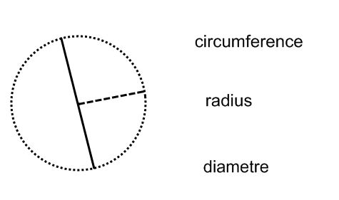
Circles - A reminder

Slide 2
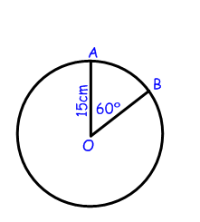
Finding an arc length
An is a fraction of a circles' circumference
For every circle you get a arc and a arc
Example
Find the length of the minor arc AB.
Step 1: Calculate the full circumference
C = πd
Step 2: Find the required fraction of the circumference
Arc AB = x 94.2
= cm
360
Note: For the major arc, multiply by the fraction
360

Slide 3
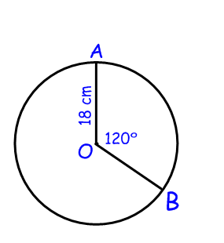
Finding the area of a sector
A is the area of a circle trapped between
the two and the
There is a and a sector.
Example
Find the area of the minor sector.
Step 1: Calculate the area of the whole circle
A = πr²
Step 2: Calculate the required fraction
Minor sector AOB = x 1017.36
= cm²
360
360
Note: For the major sector, multiply by the fraction

Slide 4
Finding the angle at the centre, given the arc length
Rearrange the formula to find the angle at the centre
x circumference = arc length
angle (xº)
360º
angle (xº) x circumference = arc length x
arc length
Angle (xº) = x 360º

Slide 5
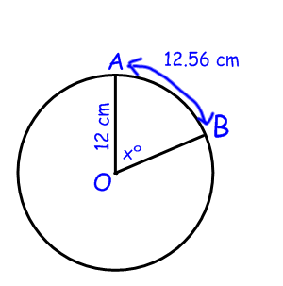
Example
If the arc length AB of a circle, radius 12cm, is 12.56cm, find the angle at the centre
Step 1: Find the circumference
C = πd
Step 2: Find the angle at the centre (xº)
xº = _____ x 360º
xº =
arc length
circumference
Angle (xº) = x 360º

Slide 6
Finding the angle at the centre, given the sector area
Rearrange the formula to find the angle at the centre
x total area = sector area
angle (xº)
360º
angle (xº) x total area = sector area x
sector area
Angle (xº) = x 360º

Slide 7
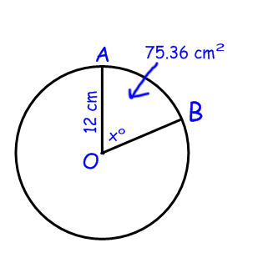
Example
Find the angle at the centre, given that the area of the minor sector AOB is 75.36cm² and the radius is 12cm.
Step 1: Find the total area
A = πr²
Step 2: Find the angle at the centre (xº)
xº = ______ x 360º
xº =
sector area
total area
Angle (xº) = x 360º

Slide 9
Circles - A reminder
π x radius²
πr²
π x diameter
πd

Slide 10
Finding an arc length
An is a fraction of a circles' circumference
arc
minor
major
For every circle you get a arc and a arc
Example
Find the length of the minor arc AB.
Step 1: Calculate the full circumference
C = πd
= 3.14 x 30
= 94.2 cm
Step 2: Find the required fraction of the circumference
Arc AB = x 94.2
= cm
60
____
360
15.7
____
360
Note: For the major arc, multiply by the fraction
300

Slide 11
Finding the area of a sector
A is the area of a circle trapped between
the two and the
There is a and a sector.
sector
radii
arc
major
minor
Example
Find the area of the minor sector.
Step 1: Calculate the area of the whole circle
A = πr²
= 3.14 x 18 x 18
= 1017.36 cm²
Step 2: Calculate the required fraction
Minor sector AOB = x 1017.36
= cm²
120
____
360
339.12
240
___
360
Note: For the major sector, multiply by the fraction

Slide 12
Finding the angle at the centre, given the arc length
Rearrange the formula to find the angle at the centre
x circumference = arc length
angle (xº)
360º
angle (xº) x circumference = arc length x
360º
arc length
Angle (xº) = x 360º
circumference

Slide 13
Example
If the arc length AB of a circle, radius 12cm, is 12.56cm, find the angle at the centre
Step 1: Find the circumference
C = πd
= 3.14 x 24
= 75.36 cm
Step 2: Find the angle at the centre (xº)
xº = x 360º
xº =
arc length
circumference
Angle (xº) = x 360º
12.56
75.36
60º

Slide 14
Finding the angle at the centre, given the sector area
Rearrange the formula to find the angle at the centre
x total area = sector area
angle (xº)
360º
angle (xº) x total area = sector area x
360º
sector area
Angle (xº) = x 360º
total area

Slide 15
Example
Find the angle at the centre, given that the area of the minor sector AOB is 75.36cm² and the radius is 12cm.
Step 1: Find the total area
A = πr²
= 3.14 x 12²
= 452.16 cm²
Step 2: Find the angle at the centre (xº)
xº = x 360º
xº =
sector area
total area
Angle (xº) = x 360º
75.36 452.16
60º

Slide 16
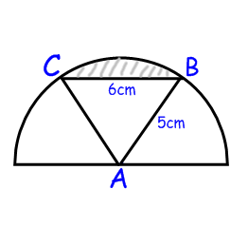
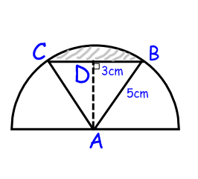
Extra - Area of a segment
A chord connects two points on the circumference, not through the centre.
A segment is the area between a chord and the circumference.
Area of segment = area of sector – area of unused triangle
Example
Calculate the area of the segment of a circle of radius 5cm, where the chord length is 6cm.
Step 1: Find the angle at the centre, using trigonometry
sin xº = = = 36.8698…º
so 2xº = 2 x 36.8698
= 73.7º (to 3 s.f.)
Step 2: Find the area of the sector
Sector area = x πr²
= x π x 5²
= 16.1 cm² (to 3 s.f.)
Step 3: Find the length of AD, using pythagoras
AC² = AD² + CD²
Opposite 3
Hypotenuse 5
angle (xº)
360º
73.7
360

