Slide 1
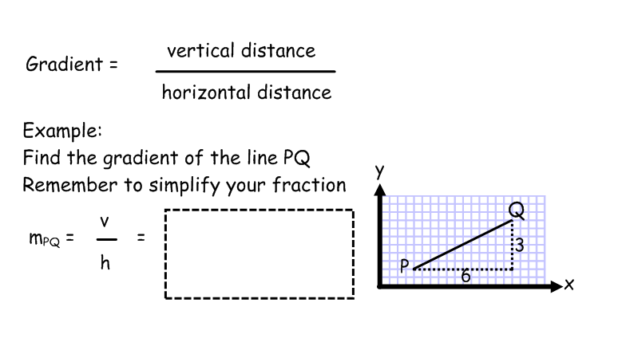
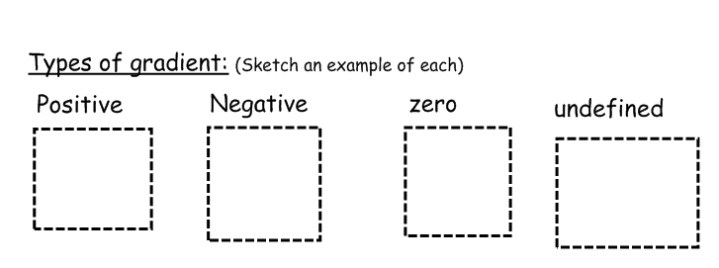
Gradient - A reminder

Slide 2
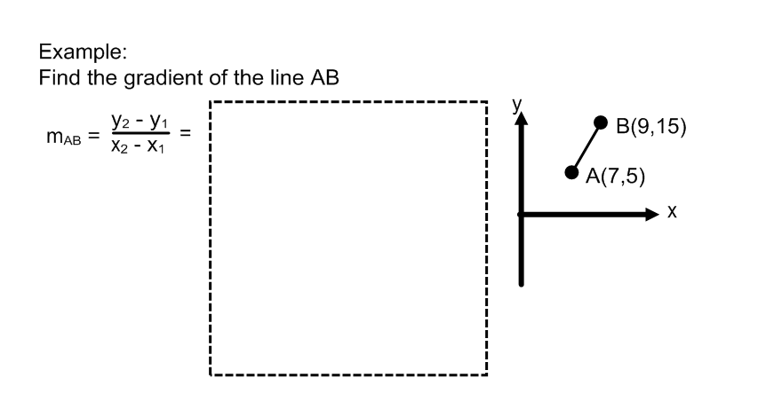
Gradient - A more mathematical approach

Slide 3
Show where got formula from

Slide 4
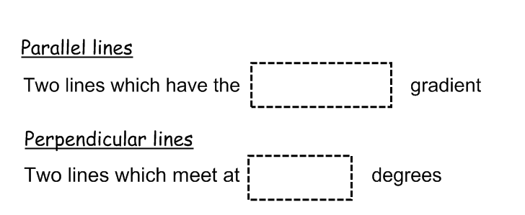
Properties of gradients
M x m = -1
And tan x = m

Slide 5
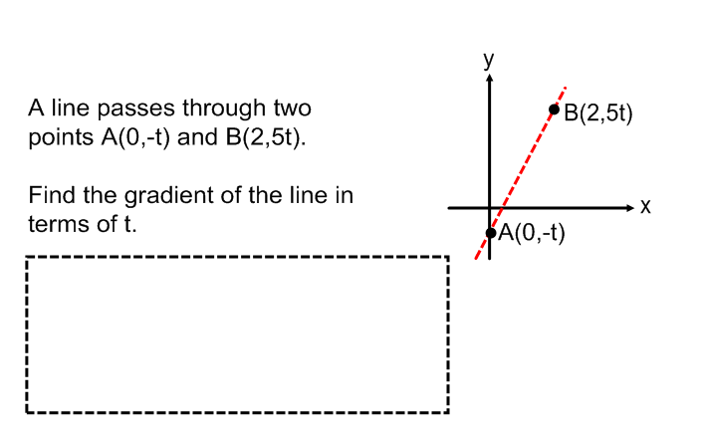
Exam Style questions

Slide 6
