Slide 1
What is a surd?
a
b
rational number
A can be expressed as an exact fraction in the form ,
where a and b are
Reminder: An is a positive or negative whole number
Examples:
4 = 0.5 = 0.333Ӟ =
If a number cannot be written as a fraction it is
Example: π = 3.14….. cannot be expressed as an exact fraction
An irrational root is called a Examples: Surds Not surds
√5 √4 = 2
$\sqrt[5]{6}$ $\sqrt[3]{8}$ = 2
Note: If a question asks for the exact value you must use the surd form, not a decimal approximation.
integers
integer
4
1
1
2
1
3
irrational
surd

Slide 2







Simplifying surds
Multiplying
Multiply the bases and take the square root of the answer
$\sqrt{a}$ x $\sqrt{b}$ =
Examples:
$\sqrt{2}$ x $\sqrt{3}$ $\sqrt{3}$ x $\sqrt{5}$
= =
= =
Dividing
Divide the bases and take the square root of the answer
$\sqrt{a}$
$\sqrt{b}$
Examples:
then
=
=
$$\sqrt{\begin{aligned}a \\ b\end{aligned}}$$
$$\sqrt{ab}$$
=
$$\sqrt{18}$$
$$\sqrt{6}$$
=
=
$$\sqrt{5}$$
$$\sqrt{80}$$
=
=
$$\sqrt{\begin{aligned}1 \\ 16\end{aligned}}$$
$$\sqrt{2 x 3}$$
$$\sqrt{3 x 5}$$
$$\sqrt{1}$$
$$\sqrt{16}$$
$$\sqrt{\begin{aligned}5 \\ 80\end{aligned}}$$
$$\sqrt{6}$$
$$\sqrt{15}$$
$$\sqrt{\begin{aligned}18 \\ 6\end{aligned}}$$
1
4
$$\sqrt{\begin{aligned}1 \\ 16\end{aligned}}$$
$$\sqrt{3}$$
Note: The bases do not have to be the same

Slide 3
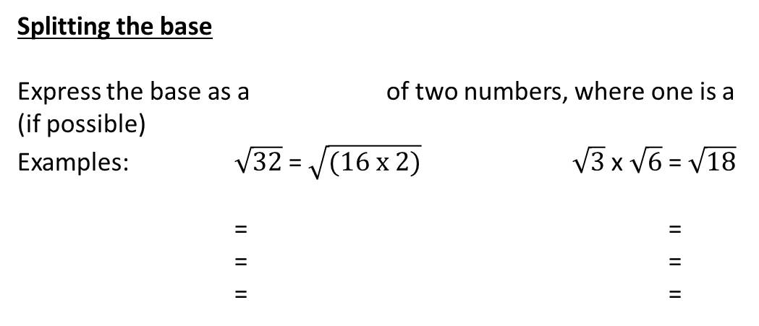
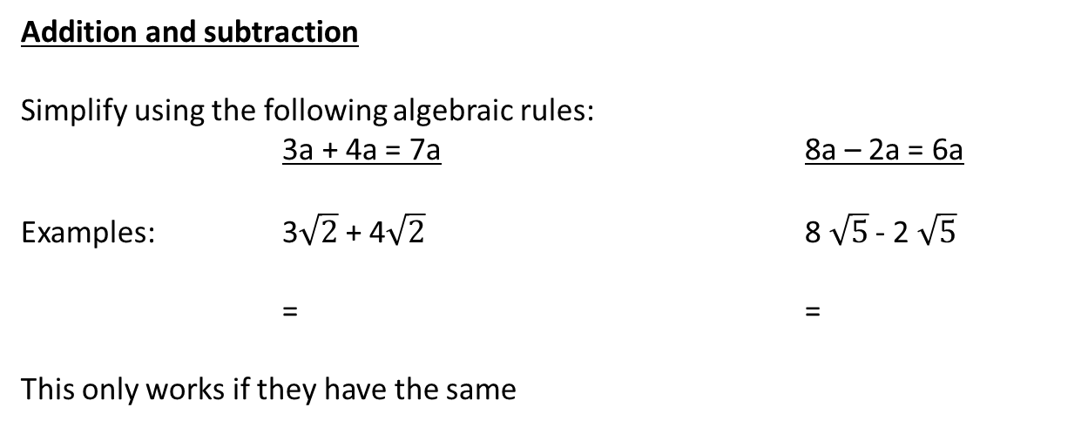
Splitting the base
Express the base as a of two numbers, where one is a
(if possible)
Examples: $\sqrt{32}$ = $\sqrt{(16 x 2)}$ $\sqrt{3}$ x $\sqrt{6}$ = $\sqrt{18}$
= =
= =
= =
product
perfect square
$\sqrt{16}$ x $\sqrt{2}$
$$\sqrt{9 x 2}$$
4 x $\sqrt{2}$
$\sqrt{9}$ x $\sqrt{2}$
4 $\sqrt{2}$
3 $\sqrt{2}$
Addition and subtraction
Simplify using the following algebraic rules:
3a + 4a = 7a 8a – 2a = 6a
Examples: 3$\sqrt{2}$ + 4$\sqrt{2}$ 8 $\sqrt{5}$ - 2 $\sqrt{5}$
= =
This only works if they have the same
7 $\sqrt{2}$
6 $\sqrt{5}$
base

Slide 4
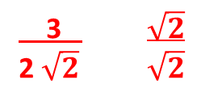

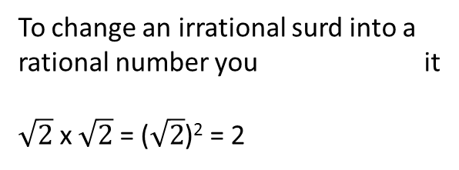
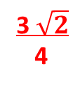
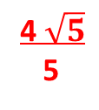

Rationalising the denominator
Reminders
These fractions are
1 4 1 x 4
2 8 2 x 4
Because you have multiplied the and by the same number
equivalent
To change an irrational surd into a rational number you it
$\sqrt{2}$ x $\sqrt{2}$ = ($\sqrt{2}$)² = 2
square
=
numerator
denominator
the denominator means multiplying out the surd, as fractions are easier to work with when they have rational denominators.
Rationalising
Examples:
1 4 3
$\sqrt{2}$ $\sqrt{5}$ 2 $\sqrt{2}$
= = =
= = =
1 $\sqrt{2}$
$\sqrt{2}$ $\sqrt{2}$
4 $\sqrt{5}$
$\sqrt{5}$ $\sqrt{5}$
3 $\sqrt{2}$
2 $\sqrt{2}$ $\sqrt{2}$
x
x
x
$$\sqrt{2}$$
2
4 $\sqrt{5}$
5
3 $\sqrt{2}$
4

Slide 5

Conjugate surds
Reminder
Difference of two squares:
(a + 2)(a -2)
= a x (a – 2) + 2 x (a – 2)
= a² -2a + 2a -4
= a² -4
Multiplying by a bracket with a allows for cancelation.
different sign
When conjugate surds are multiplied together they give a answer.
rational
Examples:
(1 + $\sqrt{2})$(1 - $\sqrt{2}$) ($\sqrt{6}$ - 5)($\sqrt{6}$ + 5)
= =
= =
= =
1(1 - $\sqrt{2}$) + $\sqrt{2}$(1 - $\sqrt{2}$)
$\sqrt{6}(\sqrt{6}$ + 5) – 5($\sqrt{6}$ + 5)
1 - $\sqrt{2}$ + $\sqrt{2}$ - 2
6 + 5 $\sqrt{6}$ - 5 $\sqrt{6}$ - 25
-1
-19
Use this extra step when the denominator you want to rationalise contains more than a surd

Slide 7
What is a surd?
a
b
A can be expressed as an exact fraction in the form ,
where a and b are
Reminder: An is a positive or negative whole number
Examples:
4 = 0.5 = 0.333Ӟ =
If a number cannot be written as a fraction it is
Example: π = 3.14….. cannot be expressed as an exact fraction
An irrational root is called a Examples: Surds Not surds
√5 √4 = 2
$\sqrt[5]{6}$ $\sqrt[3]{8}$ = 2
Note: If a question asks for the exact value you must use the surd form, not a decimal approximation.

Slide 8
Simplifying surds
Multiplying
Multiply the bases and take the square root of the answer
$\sqrt{a}$ x $\sqrt{b}$ =
Examples:
$\sqrt{2}$ x $\sqrt{3}$ $\sqrt{3}$ x $\sqrt{5}$
= =
= =
Dividing
Divide the bases and take the square root of the answer
$\sqrt{a}$
$\sqrt{b}$
Examples:
then
=
=
=
$$\sqrt{18}$$
$$\sqrt{6}$$
=
=
$$\sqrt{5}$$
$$\sqrt{80}$$
=
=
Note: The bases do not have to be the same

Slide 9
Splitting the base
Express the base as a of two numbers, where one is a
(if possible)
Examples: $\sqrt{32}$ = $\sqrt{(16 x 2)}$ $\sqrt{3}$ x $\sqrt{6}$ = $\sqrt{18}$
= =
= =
= =
Addition and subtraction
Simplify using the following algebraic rules:
3a + 4a = 7a 8a – 2a = 6a
Examples: 3$\sqrt{2}$ + 4$\sqrt{2}$ 8 $\sqrt{5}$ - 2 $\sqrt{5}$
= =
This only works if they have the same

Slide 10
Rationalising the denominator
Reminders
These fractions are
1 4 1 x 4
2 8 2 x 4
Because you have multiplied the and by the same number
To change an irrational surd into a rational number you it
$\sqrt{2}$ x $\sqrt{2}$ = ($\sqrt{2}$)² = 2
=
the denominator means multiplying out the surd, as fractions are easier to work with when they have rational denominators.
Examples:
1 4 3
$\sqrt{2}$ $\sqrt{5}$ 2 $\sqrt{2}$
= = =
= = =

Slide 11
Conjugate surds
Reminder
Difference of two squares:
(a + 2)(a -2)
= a x (a – 2) + 2 x (a – 2)
= a² -2a + 2a -4
= a² -4
Multiplying by a bracket with a allows for cancelation.
When conjugate surds are multiplied together they give a answer.
Examples:
(1 + $\sqrt{2})$(1 - $\sqrt{2}$) ($\sqrt{6}$ - 5)($\sqrt{6}$ + 5)
= =
= =
= =
Use this extra step when the denominator you want to rationalise contains more than a surd

